Slide 1
Deep Lesion Graphs in the “Wild”: Relationship Learning and Organization of Significant Radiology Image Findings in a Diverse Large-scale Lesion Database
Ke Yan, Xiaosong Wang, Le Lu, Ling Zhang,
Adam Harrison, Mohammadhadi Bagheri, Ronald Summers
IEEE CVPR 2018, Salt Lake City

Slide 2
Background
Large-scale datasets with diverse images and dense annotations are important for both computer vision and medical image
Crowd-sourcing can be used to annotate CV datasets, but MI requires considerate specialized knowledge & training
Mining Internet images via deep learning can be used in CV to acquire annotations
Can we use similar approaches to mine MI datasets?
Fortunately, like web data in computer vision, a vast amount of loosely-labeled and largely untapped data do exist in Picture Archiving and Communication Systems (PACS/RIS)

Slide 3
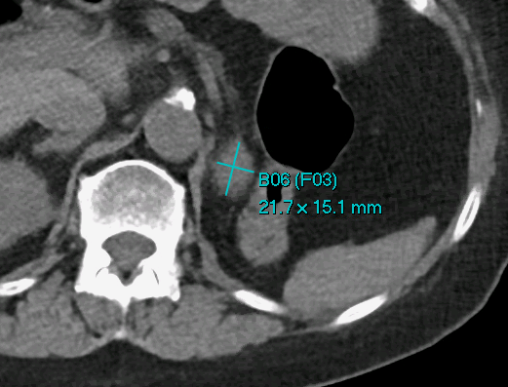
Background
Radiologists in their daily work may routinely mark and measure some significant abnormalities or “lesions” on radiology images
Sometime known as “bookmarks”
According to the RECIST (Response Evaluation Criteria in Solid Tumors) guidelines
Collected over years and stored in hospitals’ PACS/RIS
Used to assess patients’ conditions or therapy responses
Notes:
The bookmark identifiers indicate that this is bookmark number 6 (B06) and that this bookmark is part of follow-up set number 3 of bookmarks on the same lesion (F03).

Slide 4
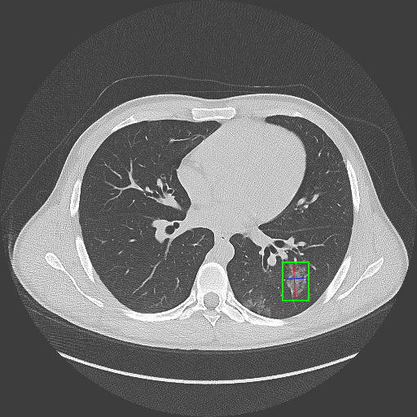
“DeepLesion” Dataset
Mined from bookmarks (RECIST diameters) in NIH’s PACS
32,120 axial CT slices from 10,594 studies of 4,427 unique patients
1–3 lesions in each image with size measurements (long-axis and short-axis)
32,735 lesions altogether
Convert diameters to a bounding-box
$(x_{min}−5,y_{min}−5,x_{max}+5,y_{max}+5)$
$x_{min}=\min\left(x_{11},x_{12},x_{21},x_{22}\right),$
$x_{max}=max(x_{11},x_{12},x_{21},x_{22})$

Slide 5
Problem Definition
Lesions in DeepLesion are basically unsorted and lack semantic labels, e.g., lung nodule, mediastinal lymph node
Our goal: understand and organize a large quantity of lesions, or oncology findings, by “automated instance-level similarity modeling & topology-discovery mining”
Discover their types and locations
Find similar lesions from a population of different patients, i.e., content-based retrieval
Track the same lesions within the same patient’s several longitudinal studies, i.e., lesion instance matching or tracking
https://www.prnewswire.com/news-releases/arterys-receives-first-fda-clearance-for-broad-oncology-imaging-suite-with-deep-learning-300599275.html
Our approach: learning expressive deep feature representations for each lesion that capture & keep the similarity relationship in type, location, and size, etc.
One of the early scientifically-viable, practical approaches on doing such AI/DL medical imaging task at scale! → precision imaging measurements for oncology ...
Notes:
The link is a related product for lung and liver lesions approved by FDA this year.
To the best of our knowledge, no prior work has been done on learning “deep lesion” similarity graph & embedding via imaging on such a “large-scale” comprehensive dataset with “weak” cues!

Slide 6
Related Work
Deep metric learning
Siamese network [1]
Triplet network
Multiple labels: triplet loss with hierarchical structures [2]
Our method shares the similar spirit with [2], but we lack well-defined supervision cues (to define which pair is more similar than the other, and logically why?)
We proposed strategies to leverage weak cues, e.g., self-supervised body part regressor and iterative refinement, etc.
[1] J. Bromley et al. Signature verification using a “siamese” time delay neural network, NIPS 1994
[2] X. Zhang et al. Embedding label structures for fine-grained feature representation, CVPR 2016
Notes:
The Siamese network is a seminal work in deep metric learning, which minimizes the distance between a pair of samples with the same label and pushes samples with different labels apart

Slide 7
Related Work
Lesion retrieval
Existing methods typically focus on one type of lesion (e.g., lung lesion or mammographic mass) and learn the similarity relationship based on fully manually-annotated labels or radiology reports
We learn deep lesion embedding on a large diverse dataset with weak cues, in a self-regularization manner when “big data” are available!
Lesion matching
Existing work generally require organ segmentation or time-consuming non-rigid volumetric registration and focus on certain lesion types
Our lesion embedding is fast and can match all “categories” of lesions
Liu, Lu, Ye, Yu, Huang: Coarse-to-fine classification via parametric and nonparametric models for computer-aided diagnosis. ACM CIKM 2011
Bi, Wu, Lu, Liu, Tao, Wolf: AdaBoost on low-rank PSD matrices for metric learning. IEEE CVPR 2011

Slide 8
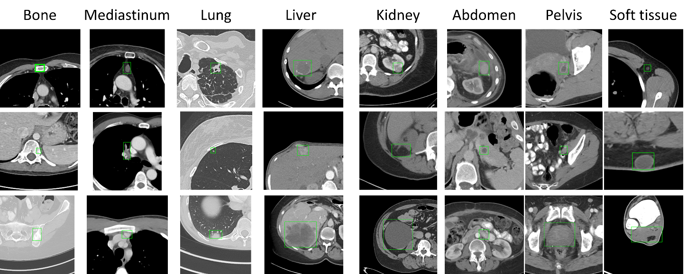
Supervision Cue (I): Lesion Type
We randomly select 30% lesions and manually label them into 8 types: bone , mediastinum, lung, liver, kidney, abdomen, pelvis, and soft tissue
Coarse-scale attributes of the lesions

Slide 9
Supervision Cue (I): Lesion Type
Mediastinum: mainly consists of lymph nodes (LNs) in the chest
Abdomen: miscellaneous ones that are not in liver or kidney
Soft tissue: lesions and LNs in the muscle, skin, fat, etc.
Among the labeled samples, we randomly select 25% (~2K) as training seeds to predict pseudo-labels, 25% as the validation set, and the other 50% as the test set
We use labeled seed samples to train a classifier (RBF SVM) on ImageNet pre-trained features and apply it to all unlabeled samples to get their pseudo-labels (may be noisy)

Slide 10
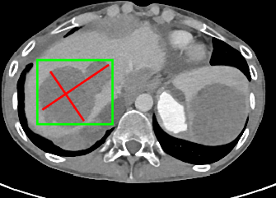
Supervision Cue (II): Relative Body Location
X and Y : easy ☺
Z : self-supervised body part regressor (SSBR) [3]
SSBR
Intuition: volumetric medical images are intrinsically structured!
The superior-inferior slice order information (self-supervision) can be leveraged to learn an deep appearance-based z predictor
z = 0.59 (from SSBR)
x = 0.28, y = 0.53 (relative)
[3] Yan, Lu, Summers. Unsupervised Body Part Regression via Spatially Self-ordering Convolutional Neural Networks, ISBI 2018

Slide 11
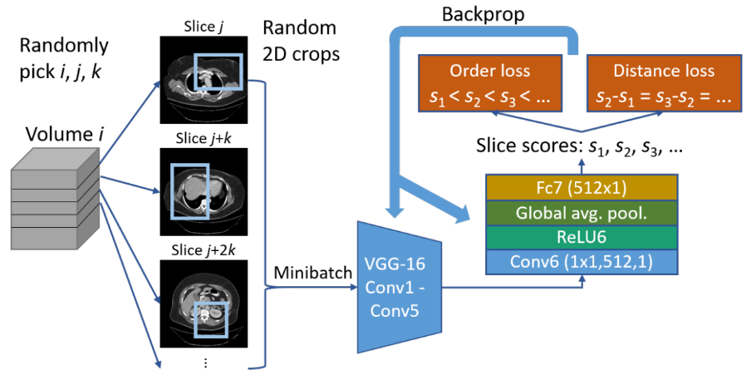
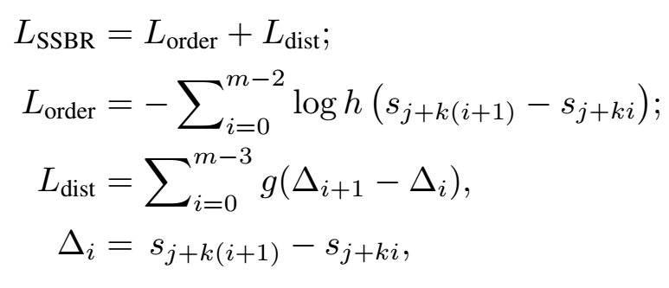
Supervision Cue (II): Relative Body Location
h is the sigmoid function, g is the smooth L1 loss
The order loss and distance loss terms collaborate to push each slice score towards the correct direction relative to other slices

Slide 12
Supervision Cue (II): Relative Body Location
Problem 1: In DeepLesion, some CT volumes are zoomed in on a portion of the body, e.g., only the left half is shown
Technique: train SSBR on random crops of the axial slices
Problem 2: SSBR does not perform well on rare body parts that are much less frequent in the training set, e.g., head and legs
Technique: train SSBR → find rare parts by checking the correlation coefficients (r) of slice scores and slice indices → train SSBR again on a resampled training set with rare parts oversampled

Slide 13
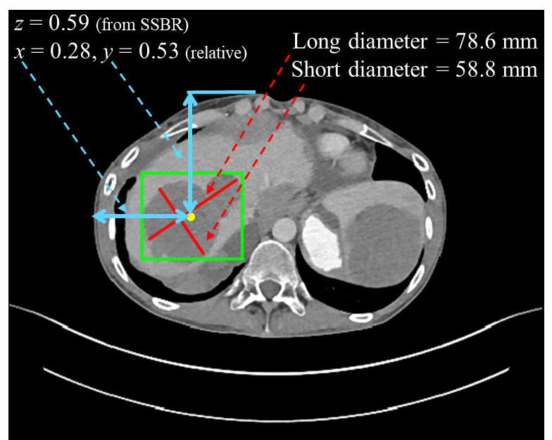
Supervision Cue (III): Lesion Size
Lengths of long and short axes of lesion diameters
Has already been annotated and measured by radiologists
Ranges from 0.2 to 343 mm with a median of 15.6 mm

Slide 14
Build Triplet Network with Sequential Sampling
With a flavor of “Gibbs Sampling”; sampling similarity orders according to each marginal/conditional distribution (e.g., body location similarity), iteratively → to comply similarity scores into the joint distribution
Cue priorities, not all cues are created equally!
Ranking a series of samples to make them self-organize and move to the right place in the feature space!

Slide 15
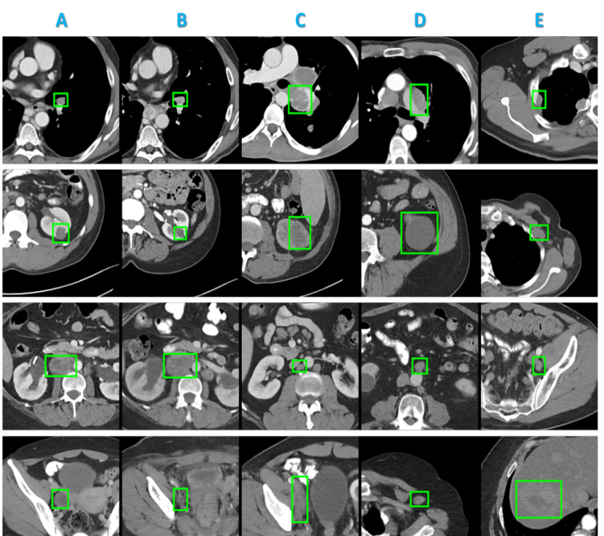
Triplet network with Sequential Sampling
Do not use hard triplet mining because of the noisy cues
Note that there is label noise in the 4th row, where lesion D does not have the same type with A ~ C (soft tissue versus pelvis)

Slide 16
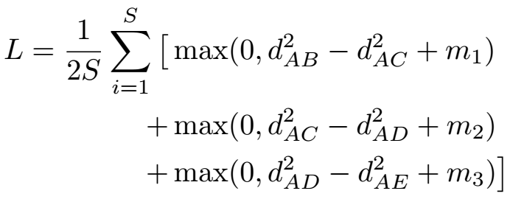
Triplet Network with Sequential Sampling
Joint Loss function
A selected sequence of 5 instances can be decomposed into three triplets: {ABC, ACD and ADE} ; Joint Loss →
Iterative refinement learning
After lesion embeddings are learned, we can retrain the lesion type classifier to get “cleaner” pseudo-labels (using deep embedding features), then fine-tune the triplet network with a lower learning rate

Slide 17
Network Architecture
Backbone: VGG-16
Multi-scale, multi-crop
Output: a 1024D feature embedding vector for each lesion instance

Slide 18
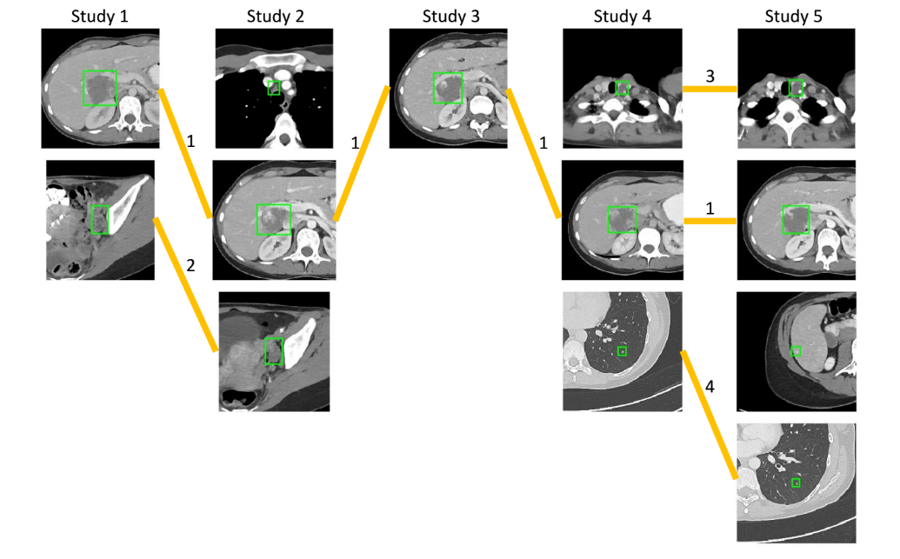
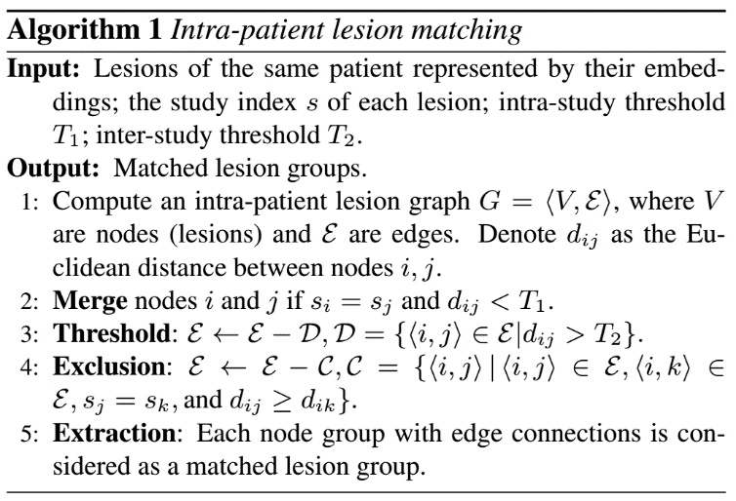
Lesion Organization: Retrieval & Matching
Inter-patient content-based lesion retrieval: finding nearest neighbors of query lesions → data-learned similarity score permitting!
Intra-patient lesion matching: graph-based edge pruning

Slide 19
Implementation Details: Image Preprocessing
Rescale image intensity to floating-point numbers in [0, 255] using a single windowing (-1024 ~ 3071 HU)
Resize spacing to 1 mm/pixel
Crop a patch with 50 mm padding around each lesion’s bounding-box
Use 3 neighboring slices (interpolated at 2 mm inter-slice intervals) to encode 3D information
No data augmentation was used

Slide 20
Implementation Details: Training Schemes
The maximum value of each dimension of the locations and sizes is normalized to 1
24 five-instance sequences per mini-batch
SGD with a learning rate of 0.002, reduced to 0.0002 at iteration 2K, converges in 3K iterations
To train SSBR, we used 800 random unlabeled CT volumes of 420 subjects from DeepLesion patient population

Slide 21
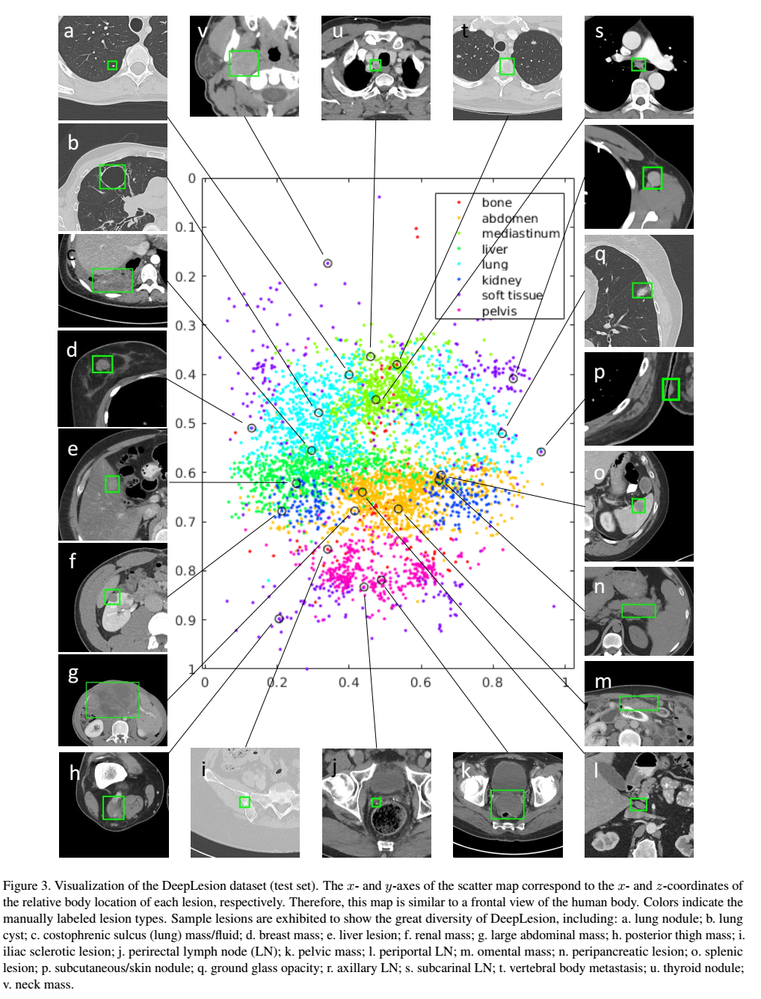
Experiments
Visualization of DeepLesion
X- and Y-axes of the scatter map correspond to the X- and Z-coordinates of the relative body location of each lesion
Frontal view of human body!
Project learned lesion embeddings into a 2D map using t-SNE (next page)
Organized by lesion type, then location

Slide 22
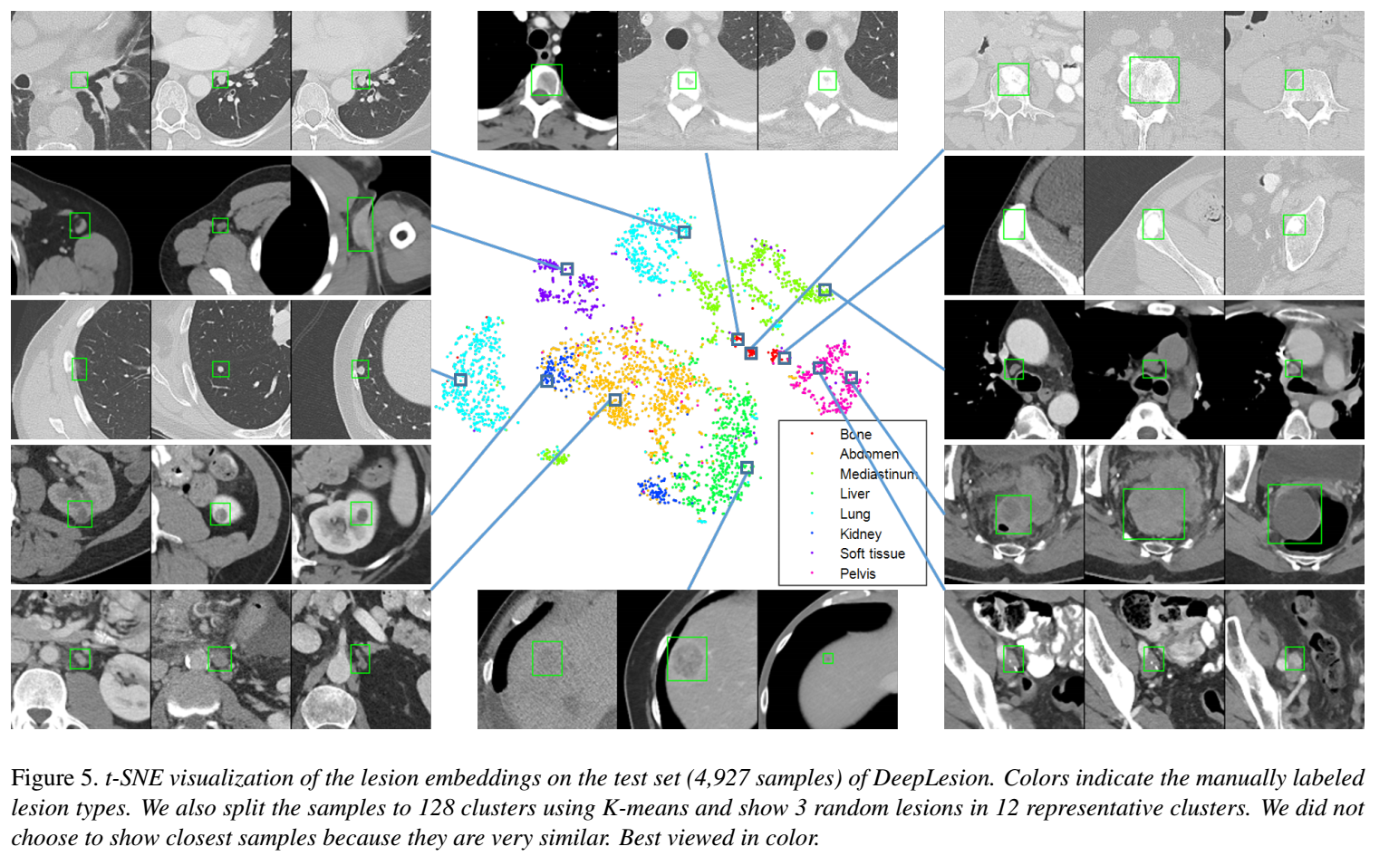

Slide 23
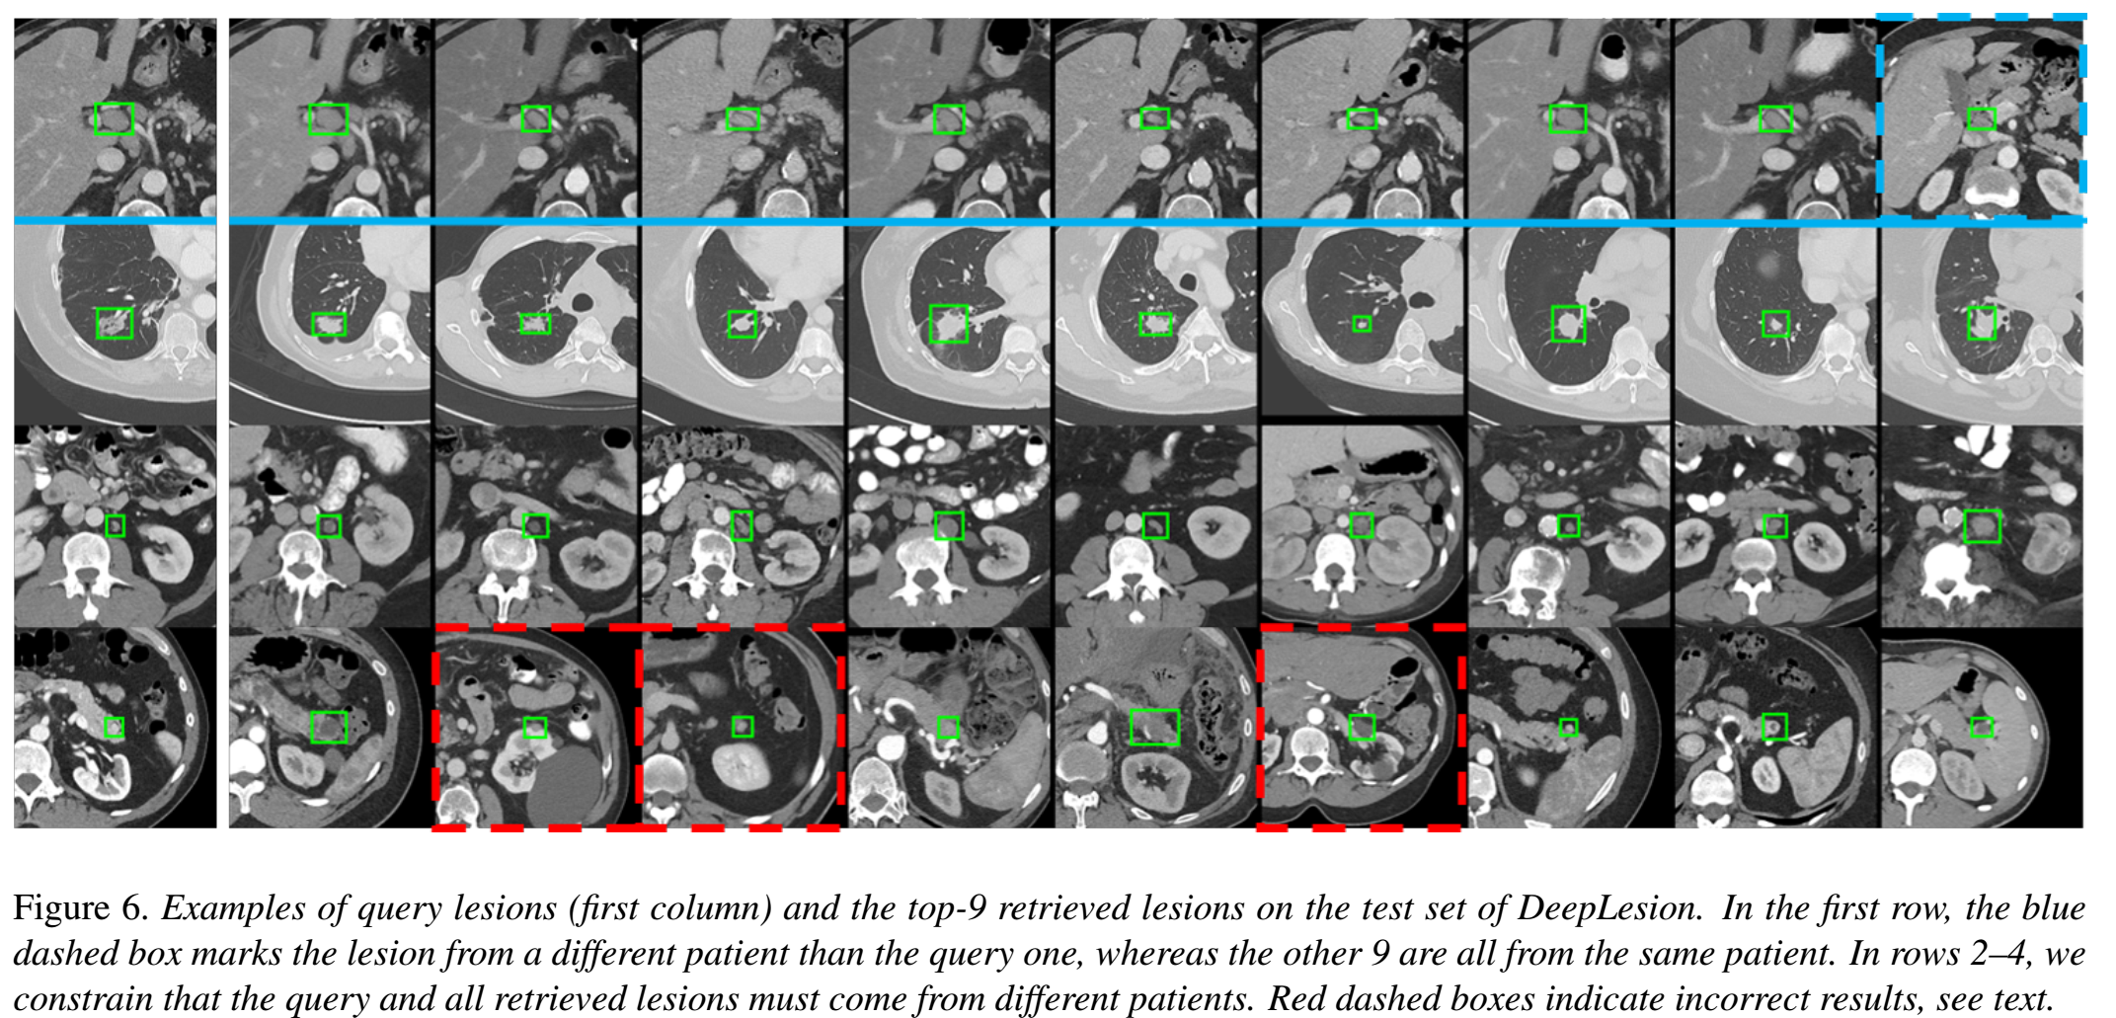
Experiments: Lesion Retrieval
Multi-scale deep lesion appearance vector via triplet network to encode lesion type, location and size (thus sub-types)!
Query Retrieved

Slide 24
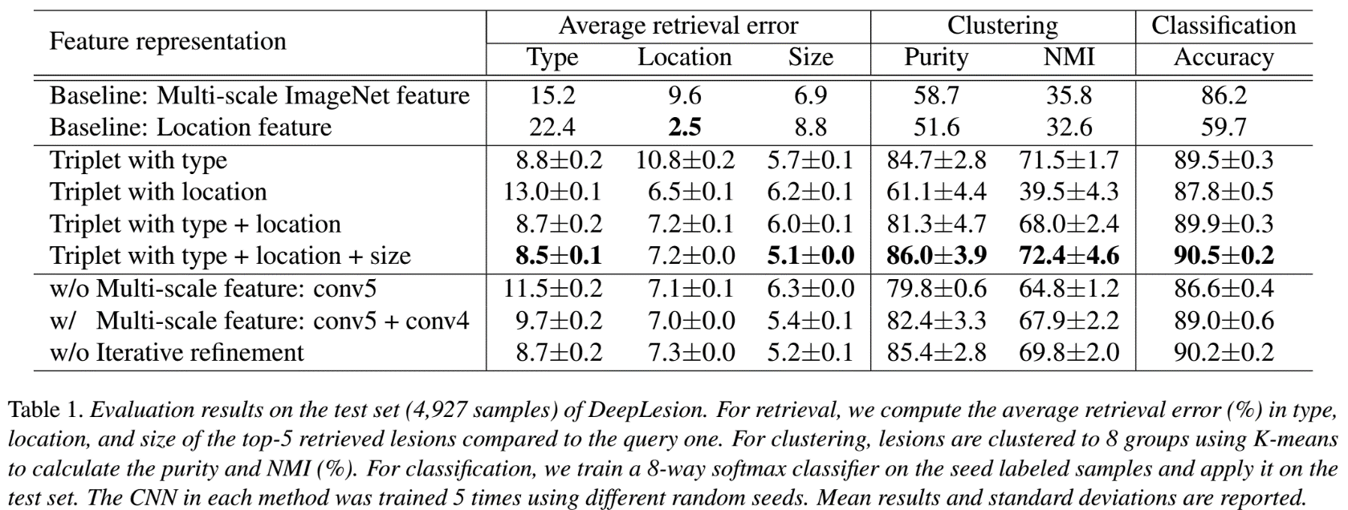
Experiments
Quantitative results of lesion retrieval (average retrieval error of continuous labels, ARE), clustering and classification

Slide 25
Experiments: Analysis & Insights
When location and size are added as supervision cues, our network performs best on lesion-type retrieval; even better than when only lesion-type is used as the cue.
Location and size provide important complementary information in learning lesion similarity embedding
When only coarse-scale features (conv5, conv4) are used, location ARE is slightly better because location mainly relies on higher-level context information
Fusing fine-level features (conv3, conv2) significantly improves type and size prediction, indicating details are important in these aspects
Iterative lesion type refinement [4] also helps!
[4] Wang et al., Unsupervised Joint Mining of Deep Features and Image Labels for Large-scale Radiology Image Categorization and Scene Recognition, IEEE WACV 2017

Slide 26
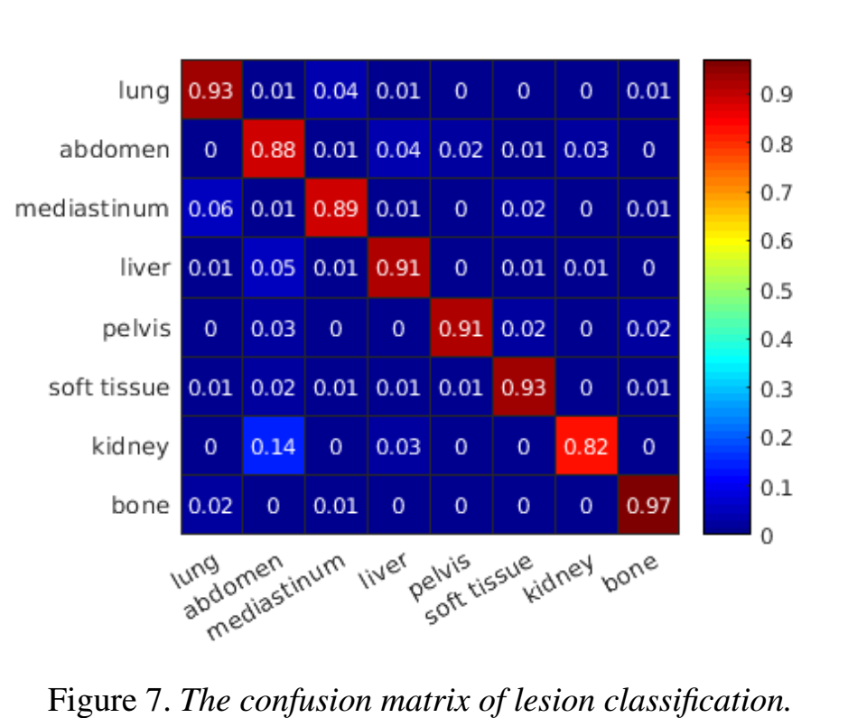
Experiments: Classification
The most confusing types are mediastinum/lung lesions, and abdomen/liver/kidney lesions, since some of them are similar in both appearance and location.

Slide 27
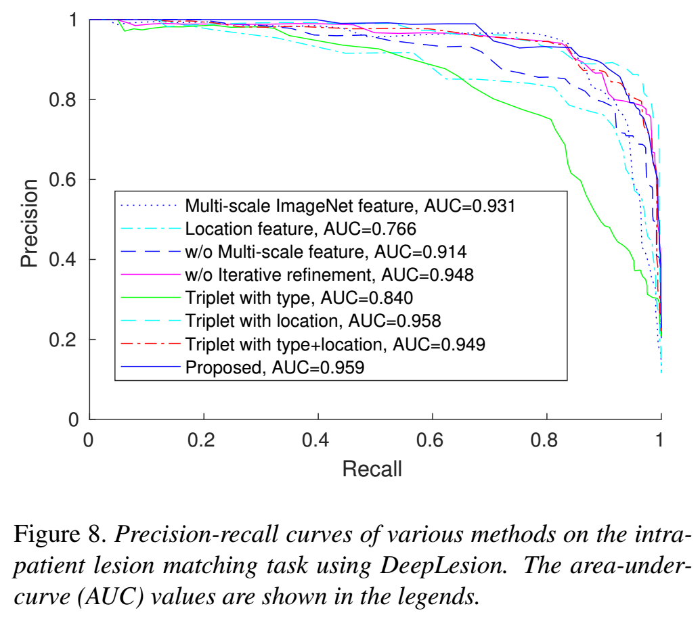
Experiments: Lesion Matching
Manually grouped 1313 lesions from 103 patients in DeepLesion to 593 groups for evaluation
1–11 lesions per group
A true positive decision assigns two lesions of the same instance to the same group, and a false positive decision assigns two lesions of different instances to the same group, etc. → Good quantitative lesion matching accuracy!

Slide 28
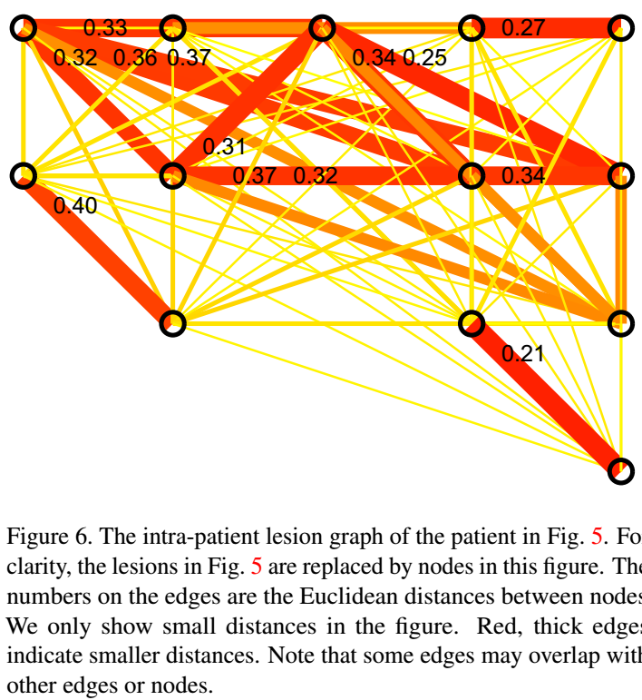
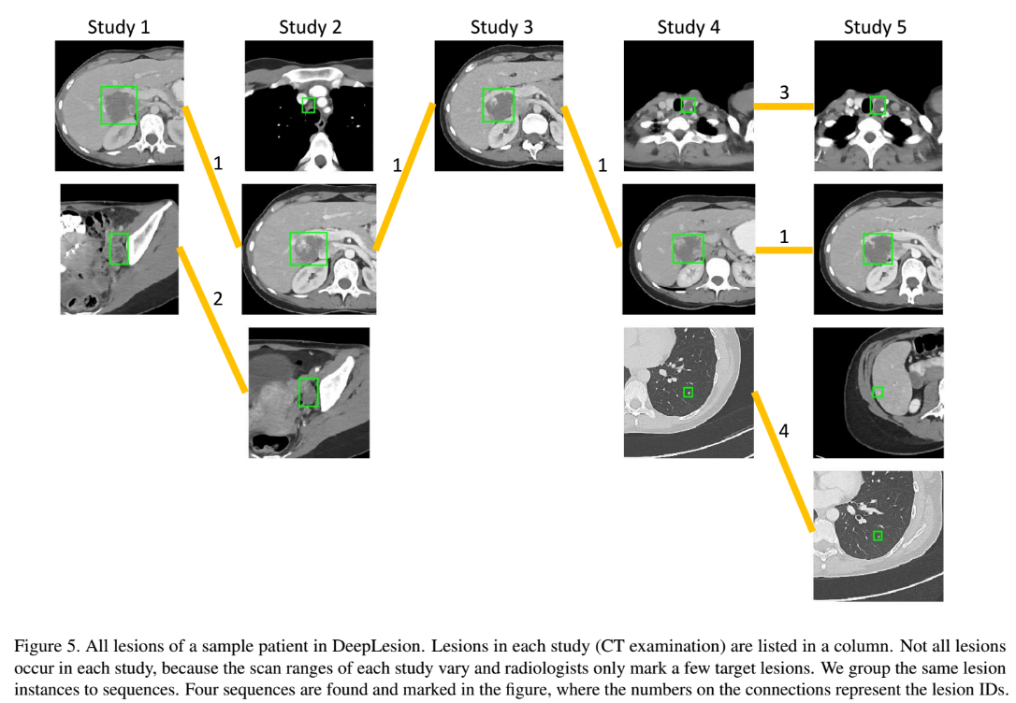
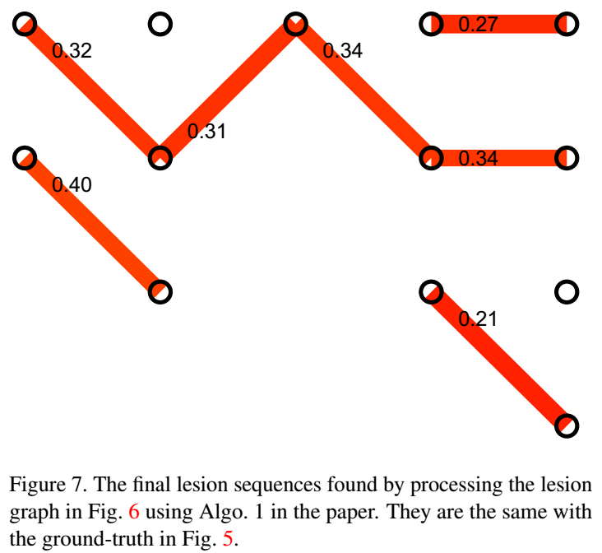
Longitudinal Lesion Matching

Slide 29
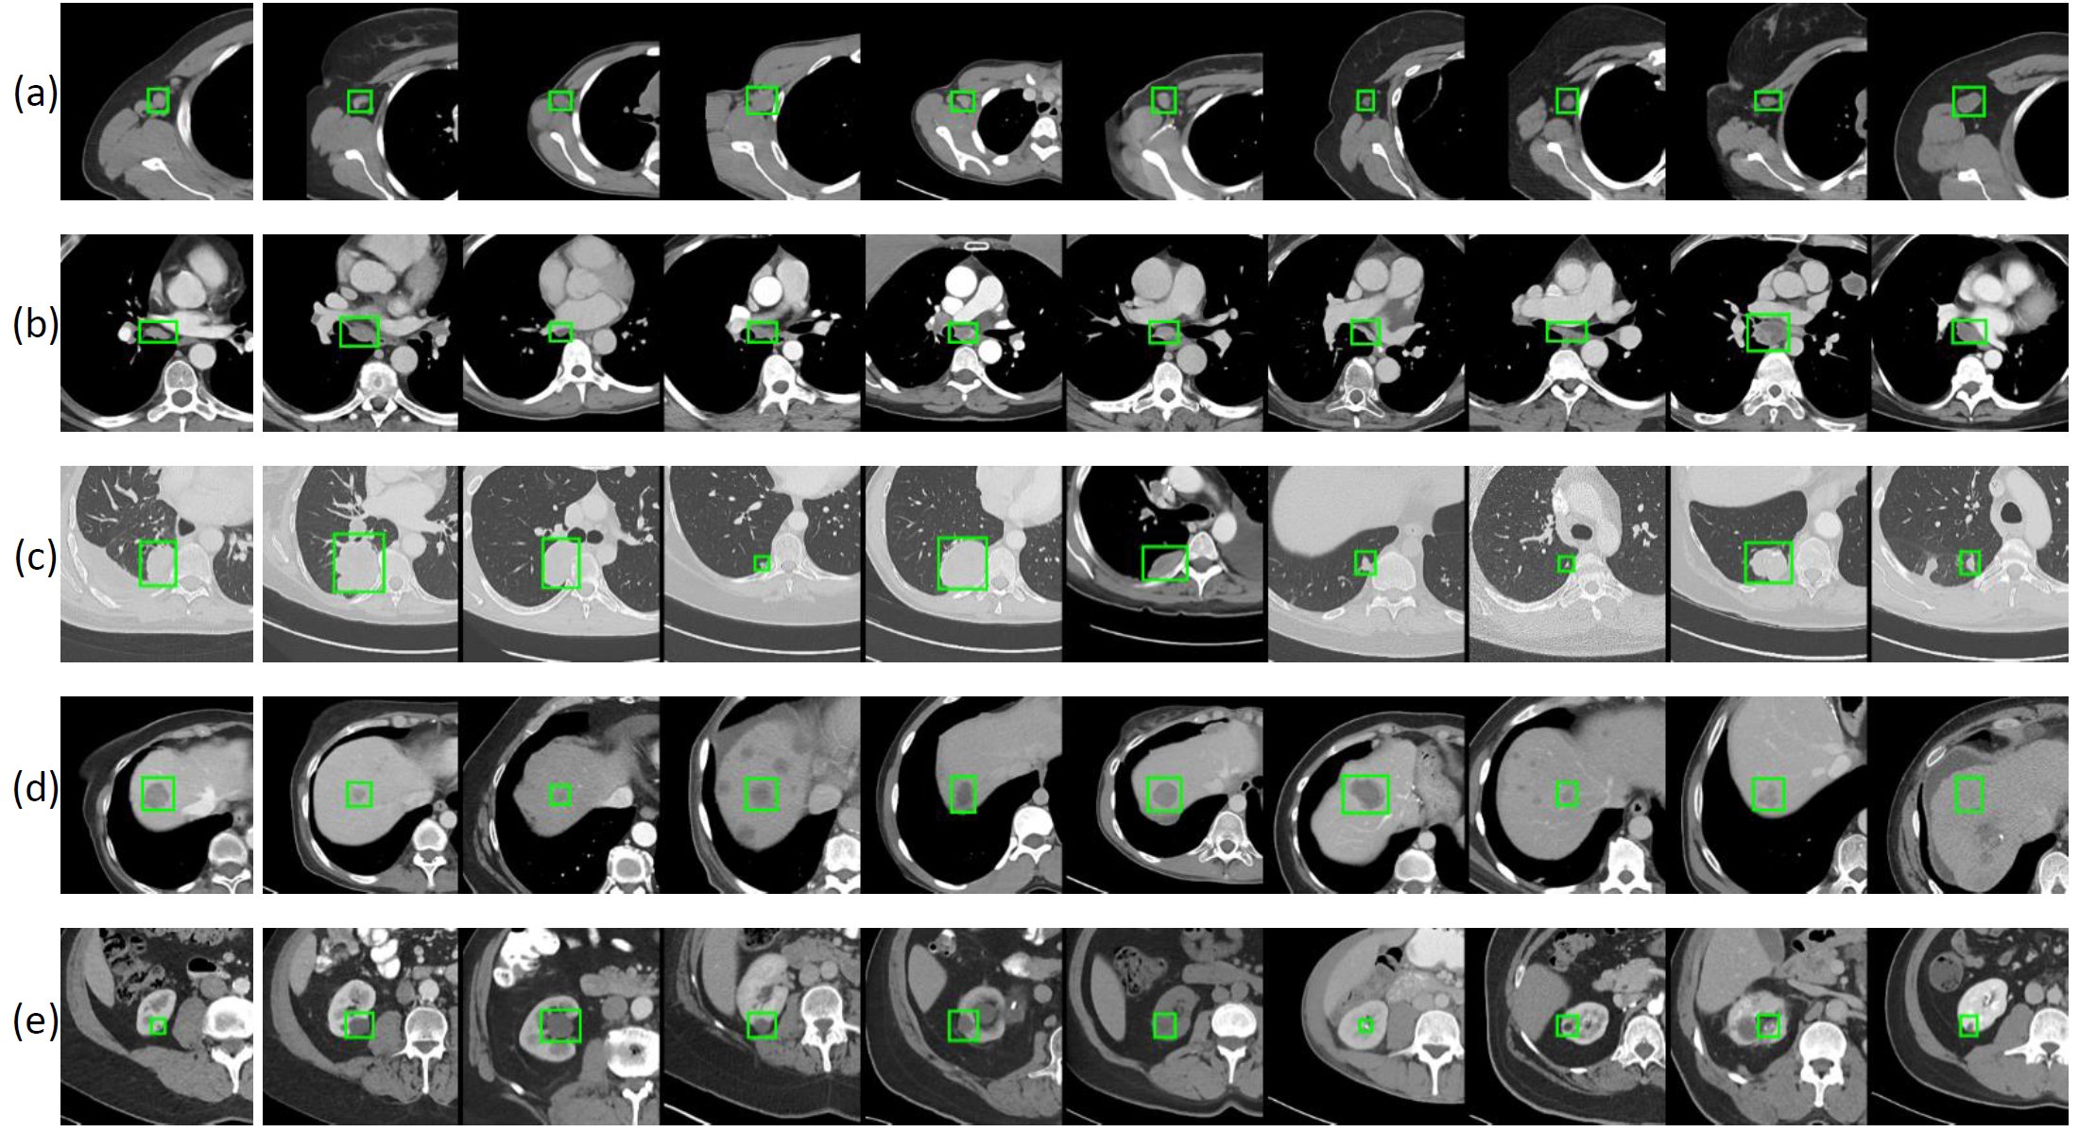

Slide 30
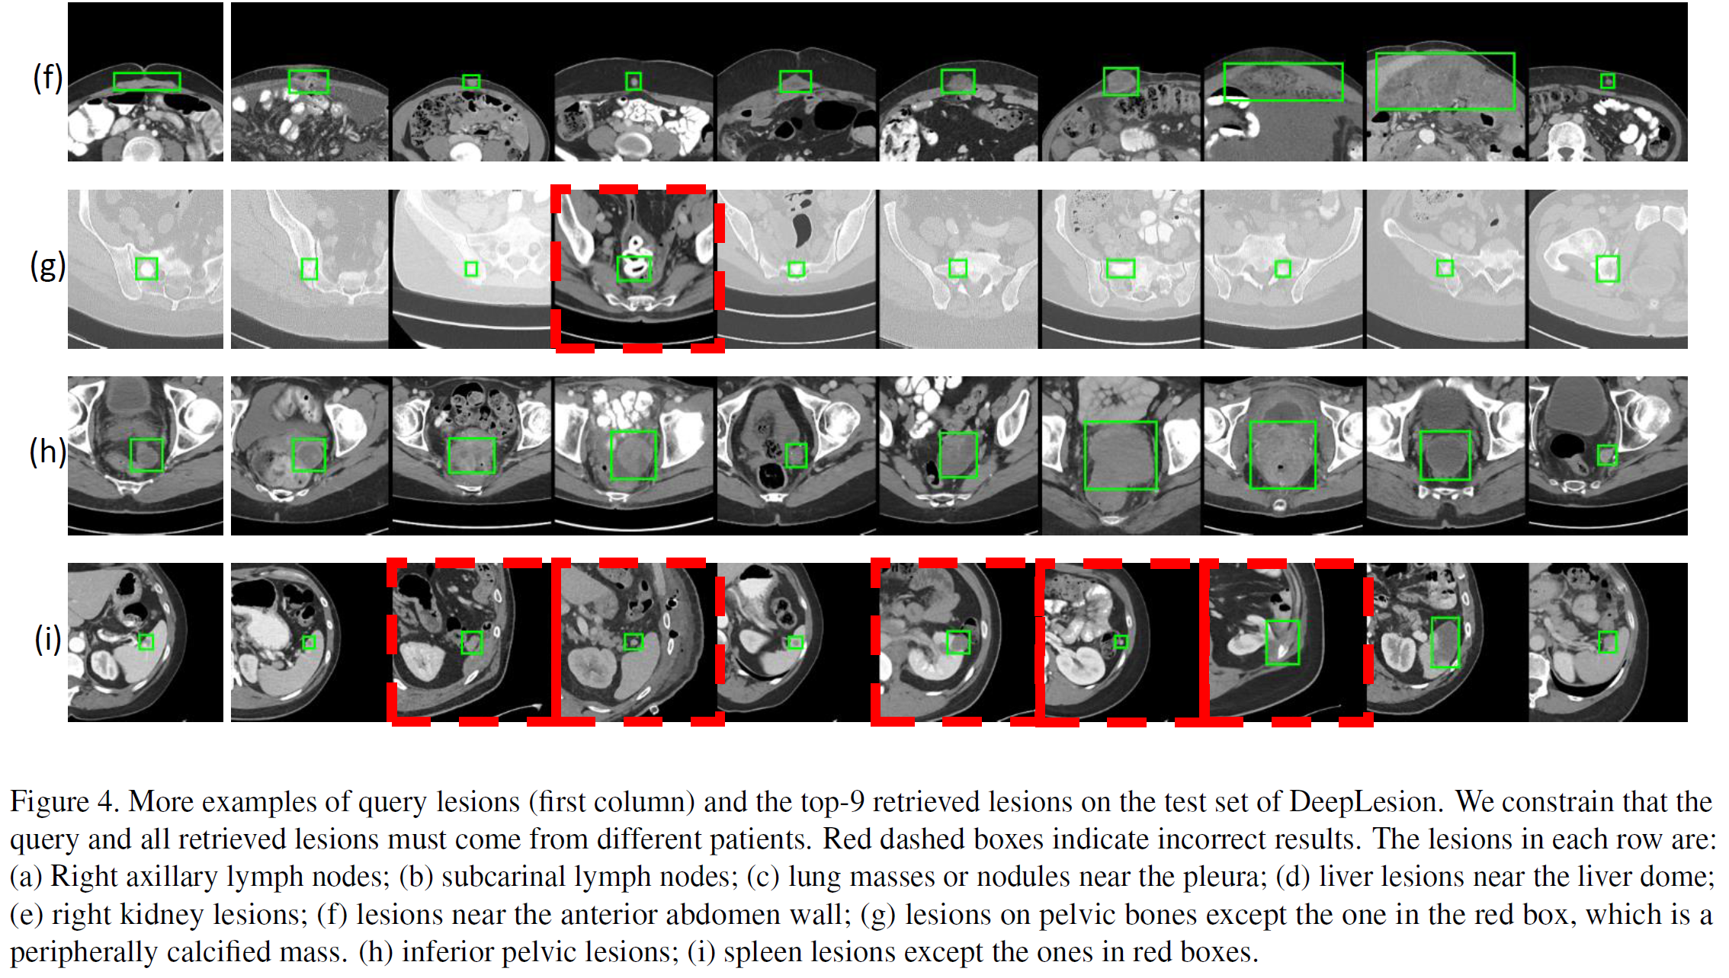

Slide 31
Conclusion
We present a large-scale and comprehensive dataset, DeepLesion, including significant radiology image findings mined from PACS
Can be used for multi-category lesion detection, retrieval, classification, segmentation, …, the first study of its kind!
Lesion graph embedding is learned with a triplet network to model their similarity relationship in type, location, and size
The only manual efforts needed are the class labels of some seed images
Non-parametric deep radiology instance/knowledge representation
Promising results are obtained in (a) inter-patient content-based lesion retrieval and (b) intra-patient lesion matching, qualitatively and quantitatively.

Slide 32
Papers on the DeepLesion project
K. Yan et al., “Deep Lesion Graphs in the Wild: Relationship Learning and Organization of Significant Radiology Image Findings in a Diverse Large-scale Lesion Database,” in CVPR (2018).
K. Yan et al., “DeepLesion: Automated Mining of Large-Scale Lesion Annotations and Universal Lesion Detection with Deep Learning,” J. Med. Imaging (2018).
J. Cai et al., “Accurate Weakly Supervised Deep Lesion Segmentation on CT Scans: Self-Paced 3D Mask Generation from RECIST,” in MICCAI (2018).
K. Yan et al., “3D Context Enhanced Region-based Convolutional Neural Network for End-to-End Lesion Detection,” in MICCAI (2018).
Y. Tang et al., “Semi-Automatic RECIST Labeling on CT Scans with Cascaded Convolutional Neural Networks,” in MICCAI (2018).

Slide 33
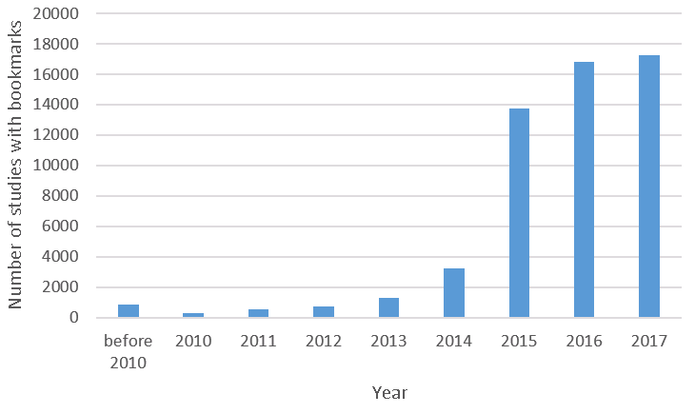
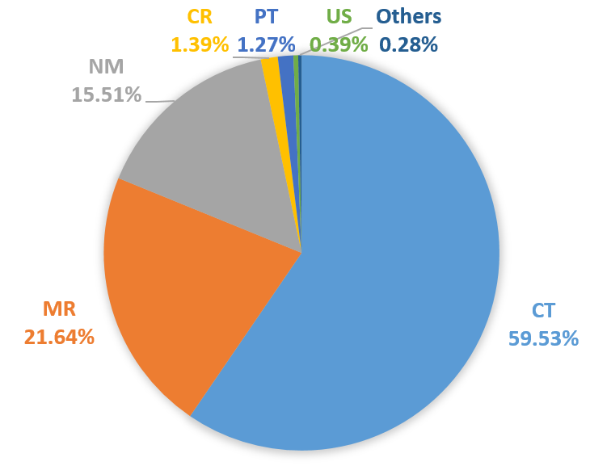
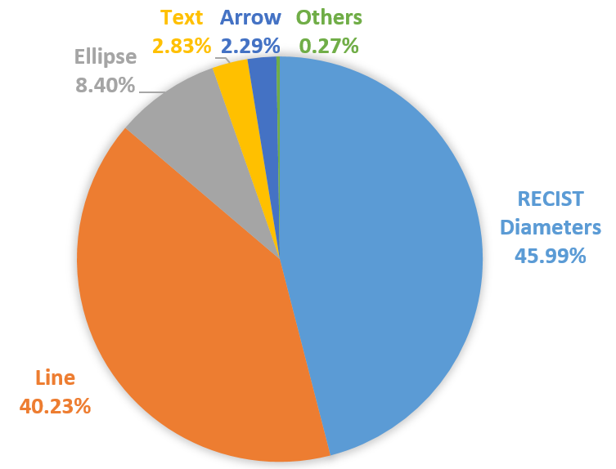
Data mining strategy
Ke Yan, Xiaosong Wang, Le Lu, Ronald M. Summers, “DeepLesion: Automated Mining of Large-Scale Lesion Annotations and Universal Lesion Detection with Deep Learning," Journal of Medical Imaging, 2018
How to mine the bookmarks?

Slide 34
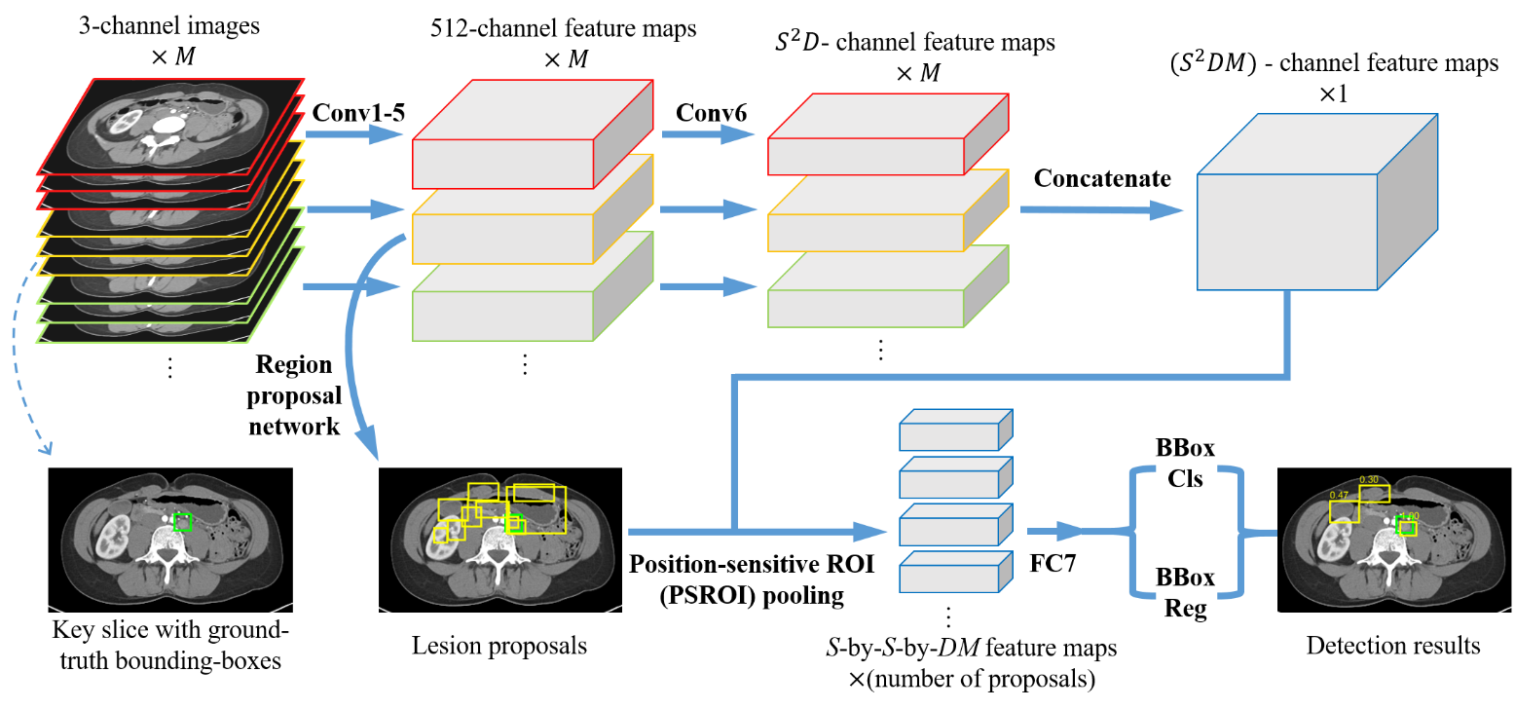
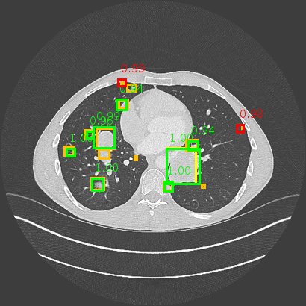
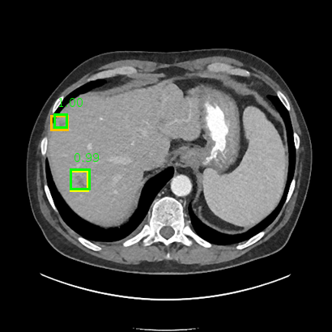
Universal lesion detection
Ke Yan, Mohammadhadi Bagheri, Ronald M. Summers, "3D Context Enhanced Region-based Convolutional Neural Network for End-to-End Lesion Detection," International Conference on Medical Image Computing & Computer Assisted Intervention (MICCAI), 2018

Slide 35
Lesion segmentation & measurement
Jinzheng Cai*, Youbao Tang*, Le Lu, Adam P. Harrison, Ke Yan, Jing Xiao, Lin Yang, Ronald M. Summers, "Accurate Weakly-Supervised Deep Lesion Segmentation using Large-Scale Clinical Annotations: Slice-Propagated 3D Mask Generation from 2D RECIST," MICCAI, 2018
Youbao Tang, Adam P. Harrison, Mohammadhadi Bagheri, Jing Xiao, Ronald M. Summers , “Semi-Automatic RECIST Labeling on CT Scans with Cascaded Convolutional Neural Networks,” MICCAI, 2018

Slide 36
Thanks!
http://yanke23.com/articles/research/2018/06/13/DeepLesion-dataset-CVPR-2018.html

